Slide 1
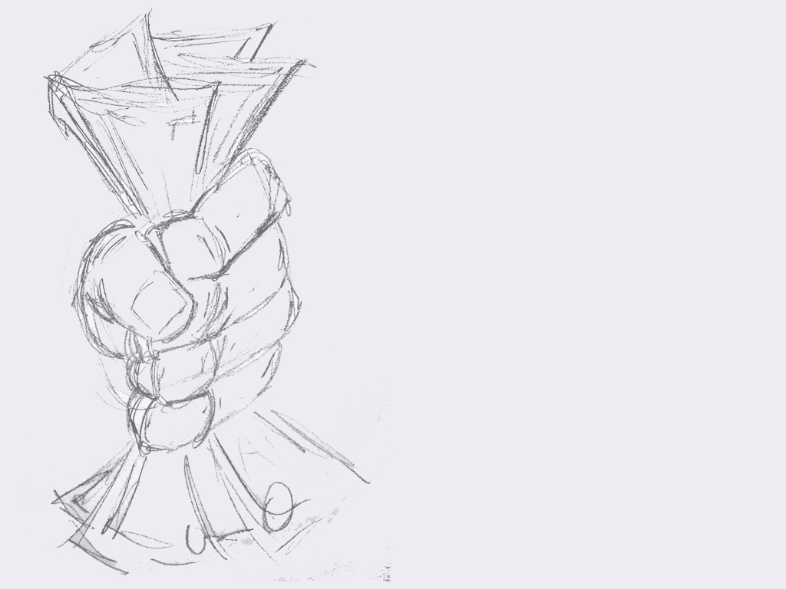
Capitalism is evil

Slide 2

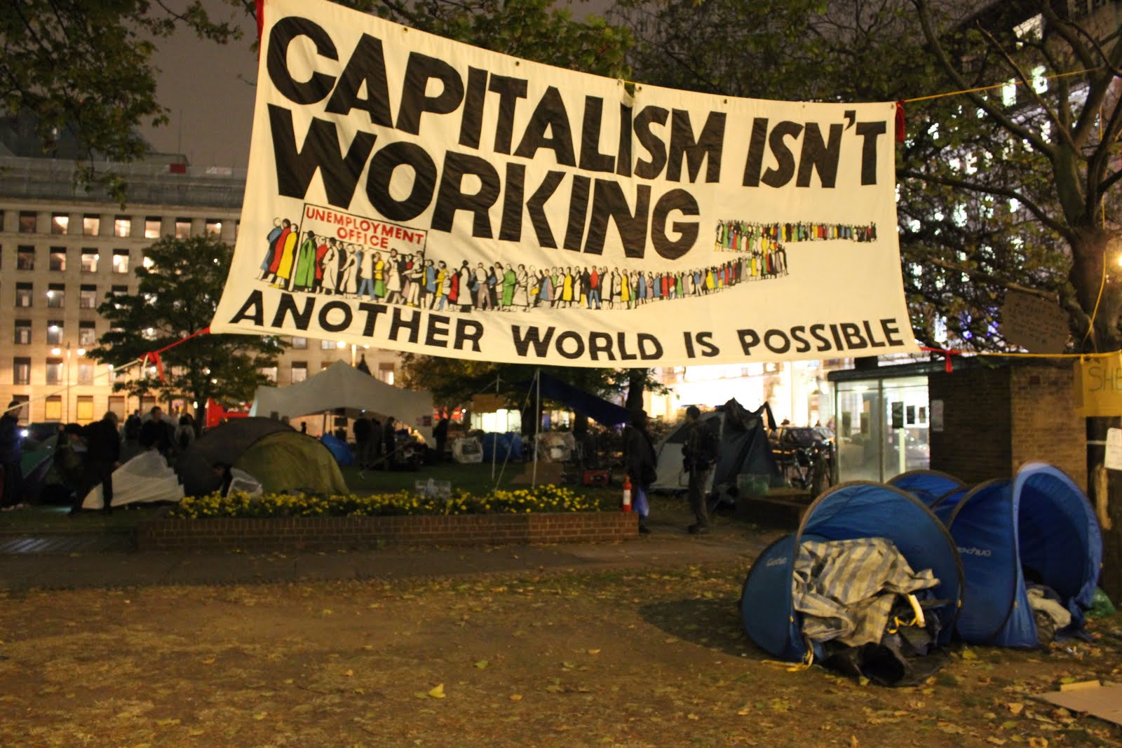

Slide 3
What is capitalism?

Slide 4
Capitalism is “the economic system which is driven by the profit-motive and depends on investment of private capital to provide the means of production, distribution, and exchange.”

Slide 5
What – a system for organising the economy
How – through everyone using their own capital
Why – for their own personal gain

Slide 6

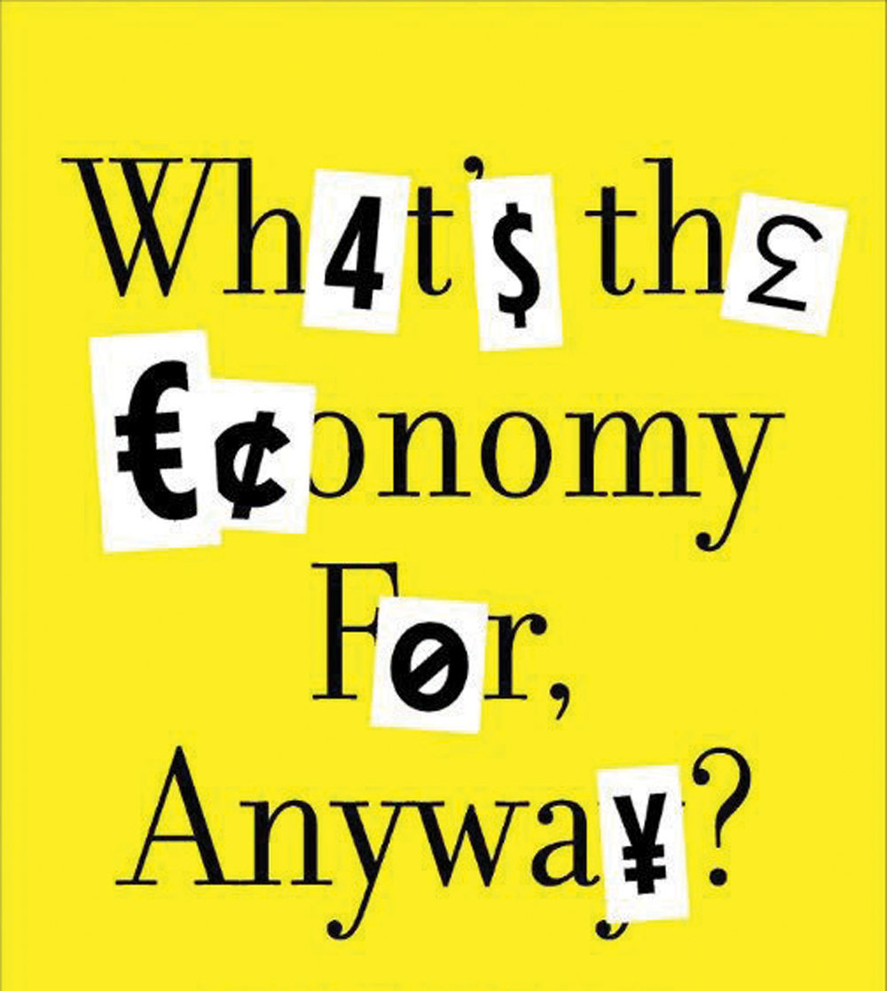

Slide 7

To make sure everyone gets a decent standard of living?
To end poverty?
To enable human flourishing?
To make people happy?
To make us richer?
All of the above?

Slide 8
What’s wrong with capitalism?

Slide 9

What’s wrong with capitalism?
Capitalism is based on selfishness
Capitalism exploits labour
Capitalism can’t end poverty
Capitalism will eat itself

Slide 10

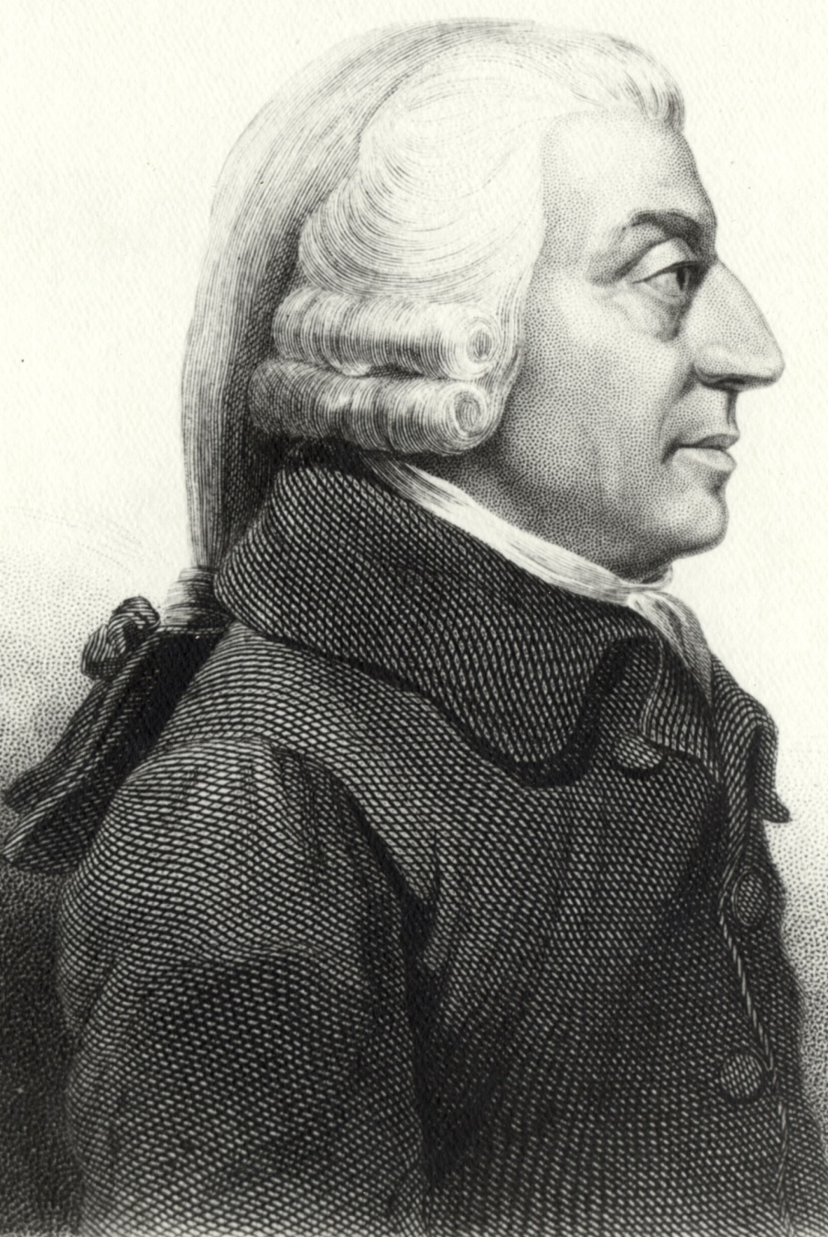
Adam Smith
1723-1790

Slide 11
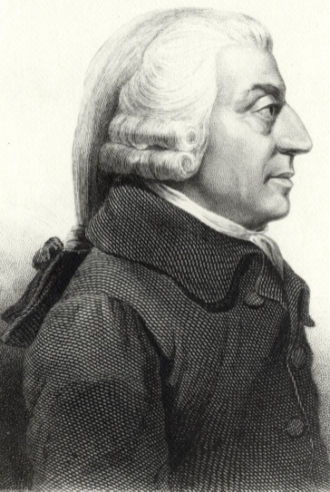
“It is not from the benevolence of the butcher, the brewer or the baker, that we expect our dinner, but from their regard to their own interest. We address ourselves, not to their humanity but to their self-love, and never talk to them of our own necessities but of their advantages.”

Slide 12
“Every individual endeavours to employ his capital… he intends only his own gain, and he is in this, as in many other cases, led by an invisible hand to promote an end which was no part of his intention.”

Slide 13
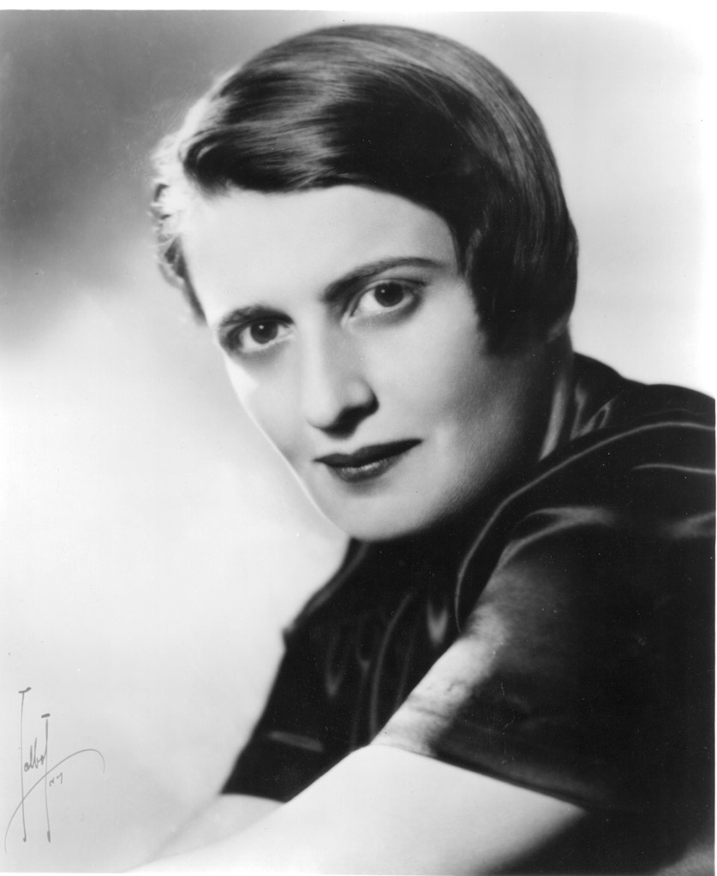
Ayn Rand
1905-1982

Slide 14

“Man—every man—is an end in himself, not a means to the ends of others; he must live for his own sake, neither sacrificing himself to others nor sacrificing others to himself; he must work for his rational self-interest, with the achievement of his own happiness as the highest moral purpose of his life.”

Slide 15
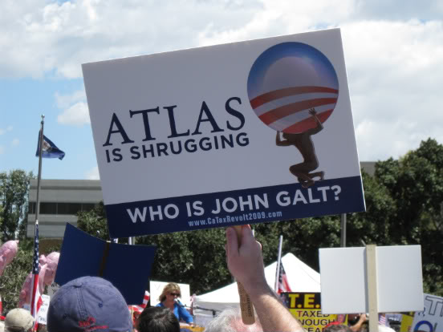

Slide 16
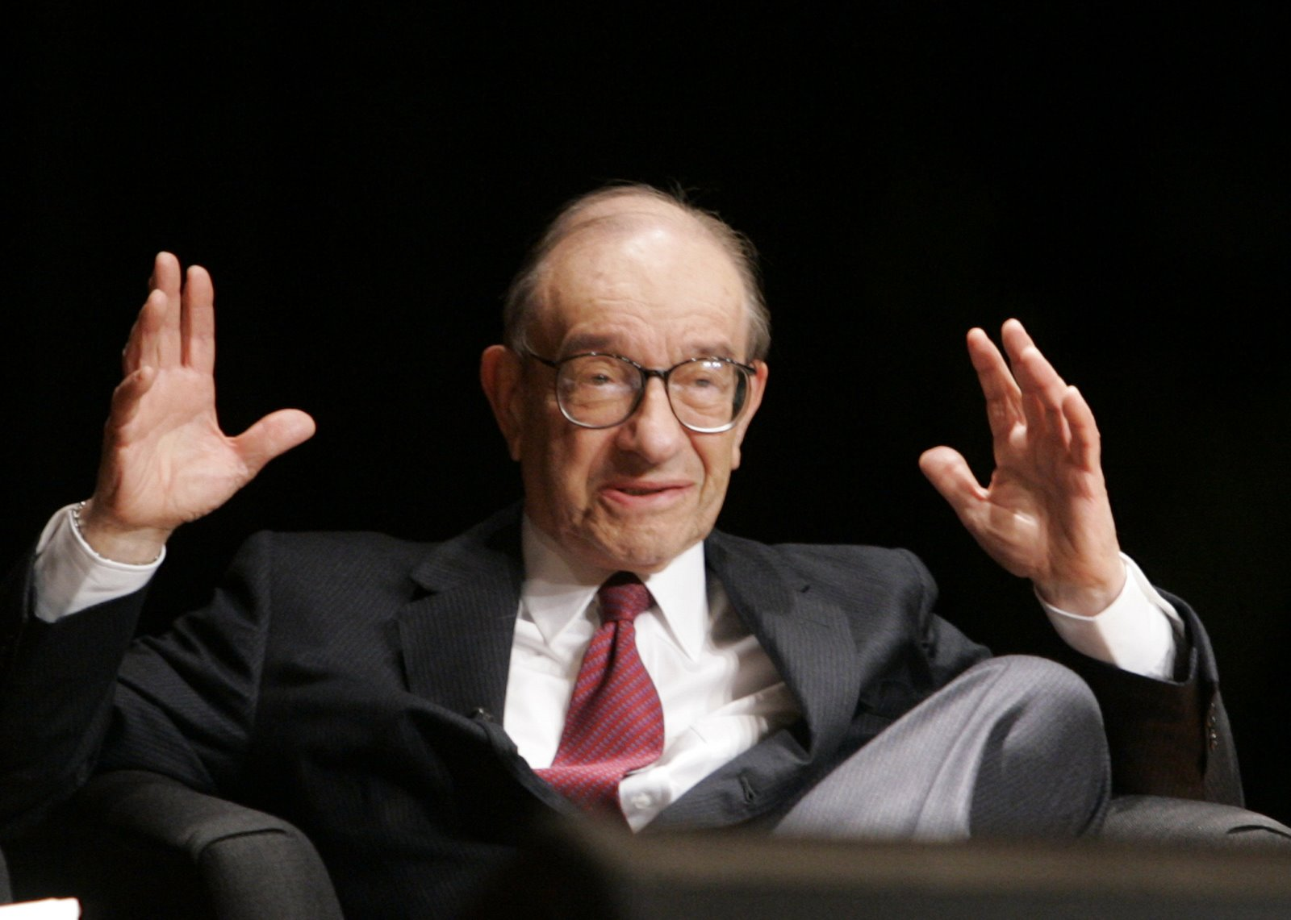

Slide 17

2. Capitalism exploits workers

Slide 18
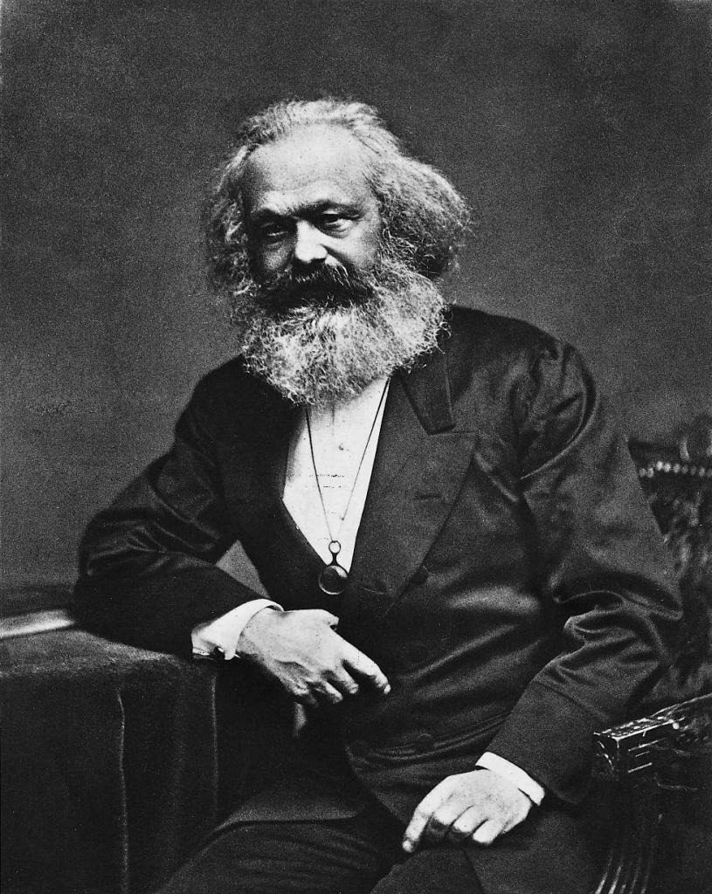
Karl Marx
1818 - 1883

Slide 19


Slide 20
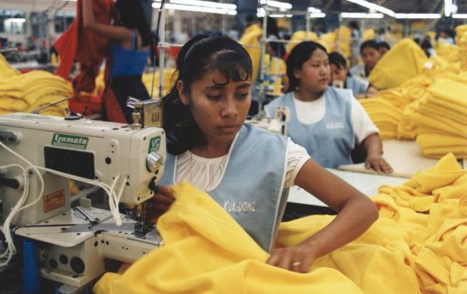

Slide 21
3. Capitalism can’t give us the things we hope for, such as ending poverty

Slide 22
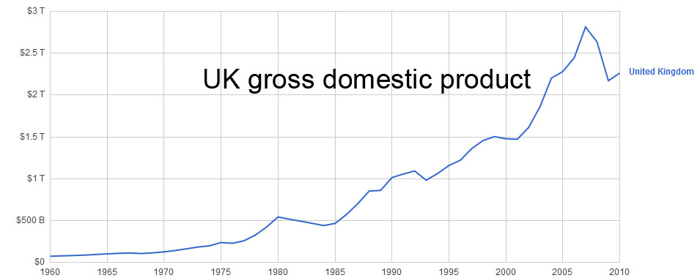

Slide 23
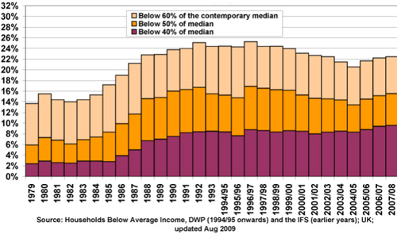

Slide 24
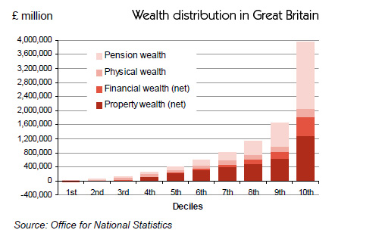

Slide 25
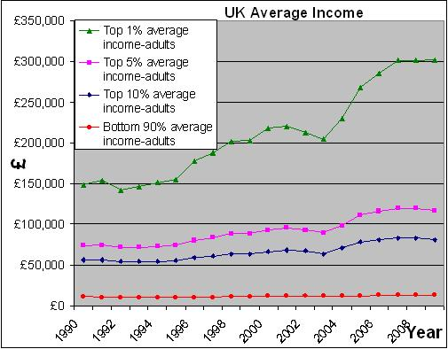

Slide 26
4. Capitalism will eat itself

Slide 27
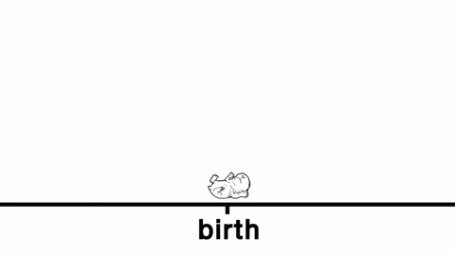

Slide 28
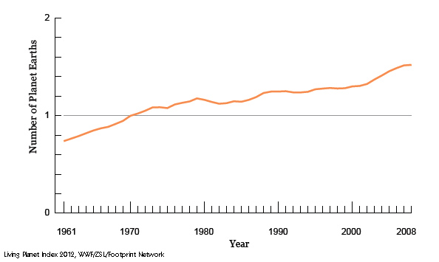

Slide 29
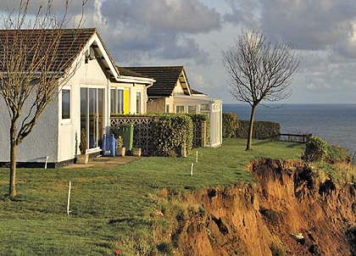
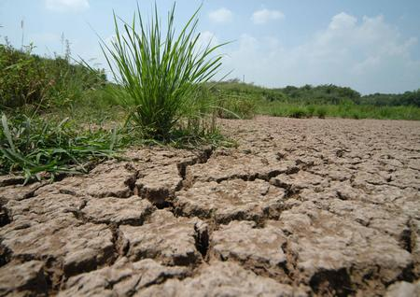
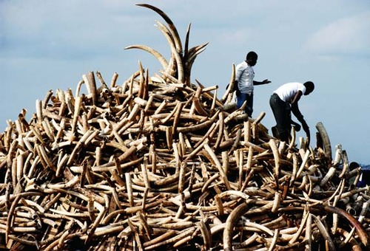
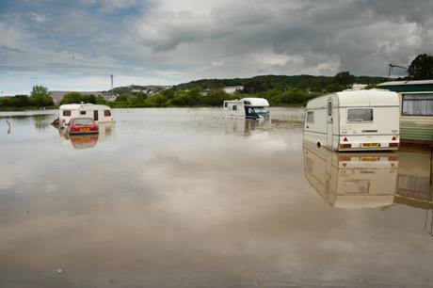

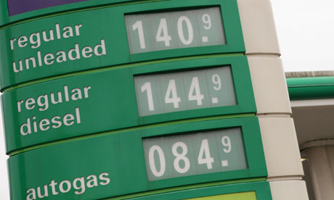
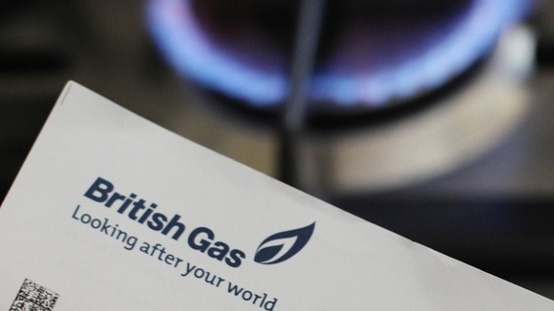
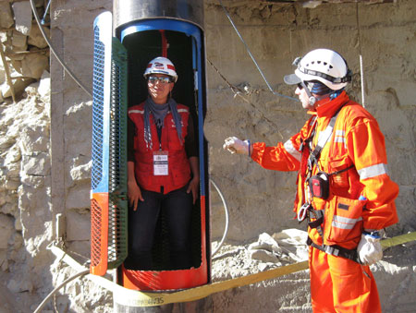
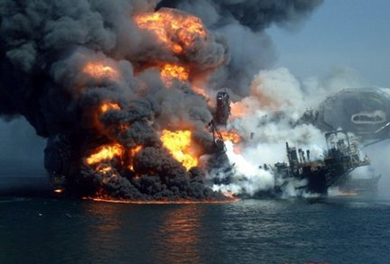

Slide 30
Is capitalism evil?
Capitalism is based on selfishness
Capitalism exploits labour
Capitalism can’t end poverty
Capitalism will eat itself

Slide 31
