Slide 1


WORLD POPULATION (7 billion)
by four income levels
Images from Dollar Street, a project from

Slide 2
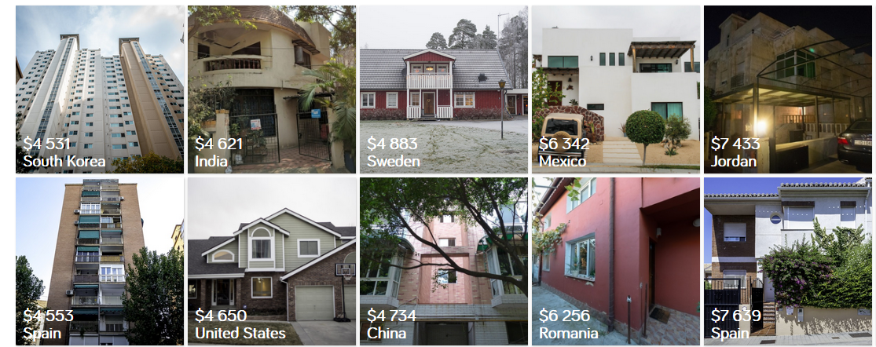

Slide 3
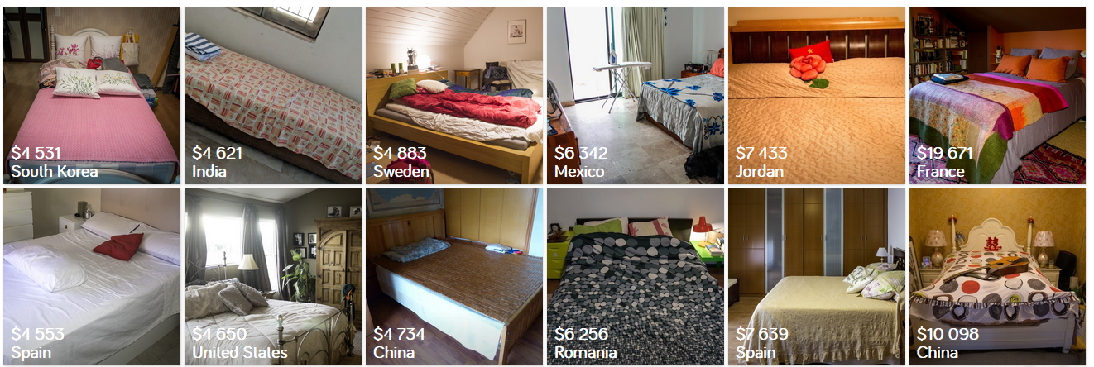

Slide 4
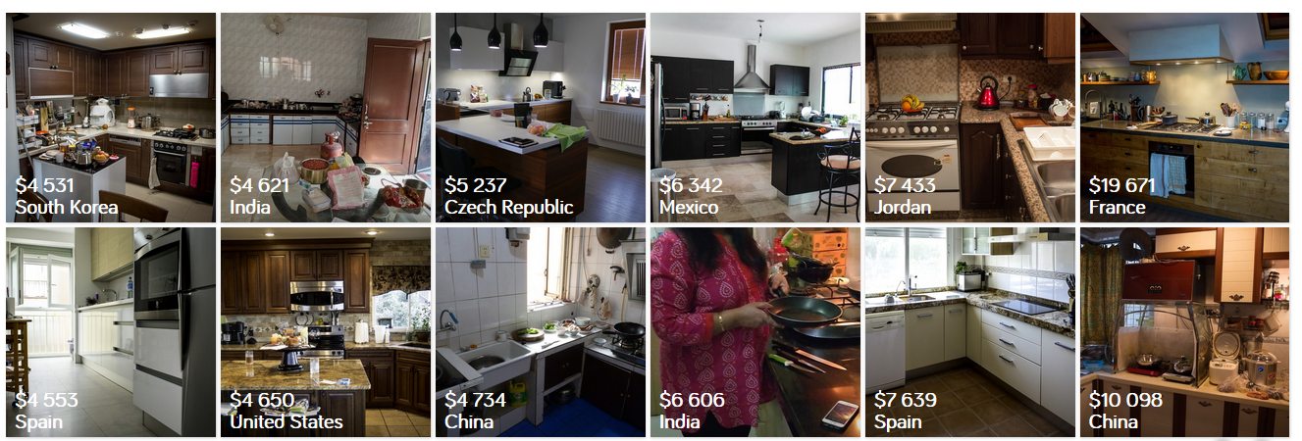

Slide 5
WORLD POPULATION (7 billion)
by four income levels
L1
L2
L3
L4
Low Income
(Extreme poverty)
Middle
Income
High Income

Slide 6
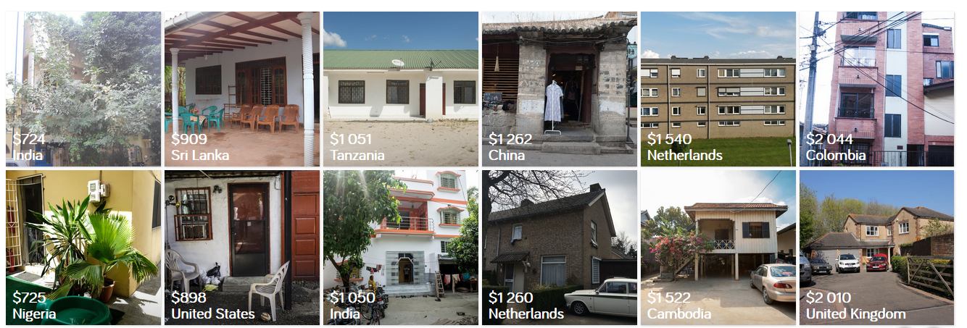

Slide 7
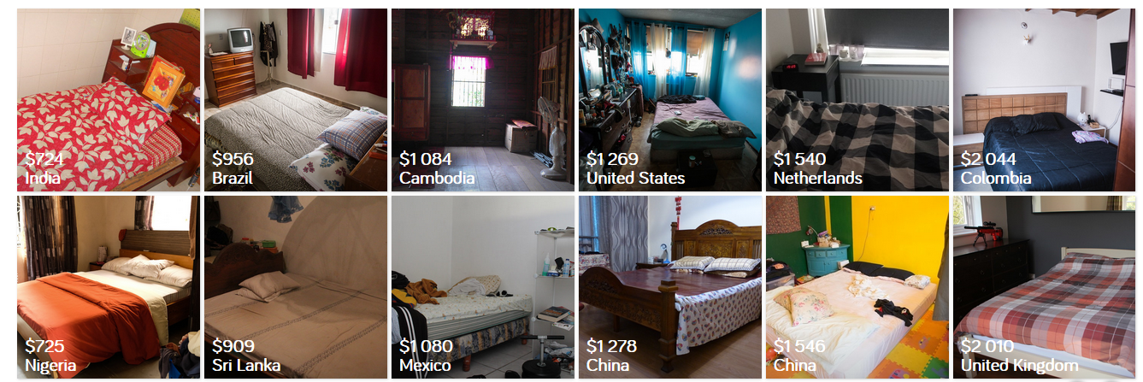

Slide 8
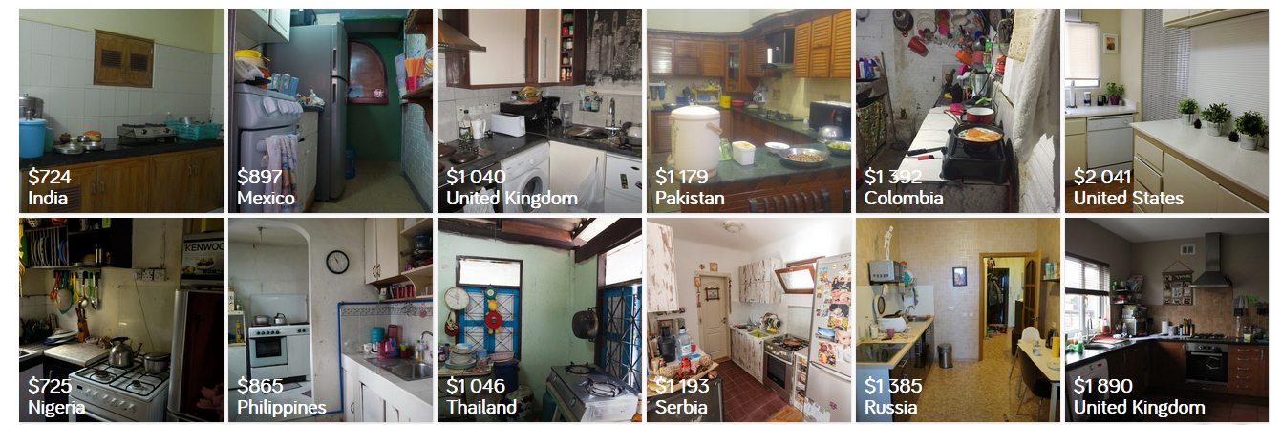

Slide 9
WORLD POPULATION (7 billion)
by four income levels
L1
L2
L3
L4
Low Income
(Extreme poverty)
Middle
Income
High Income

Slide 10
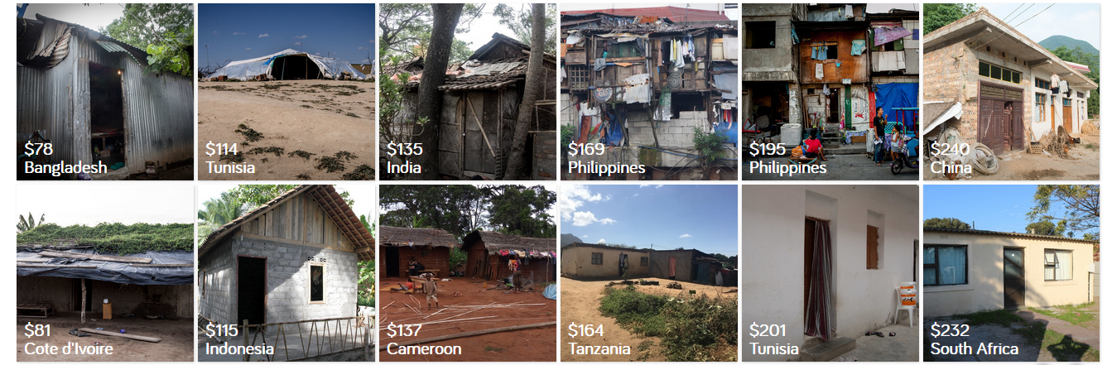

Slide 11
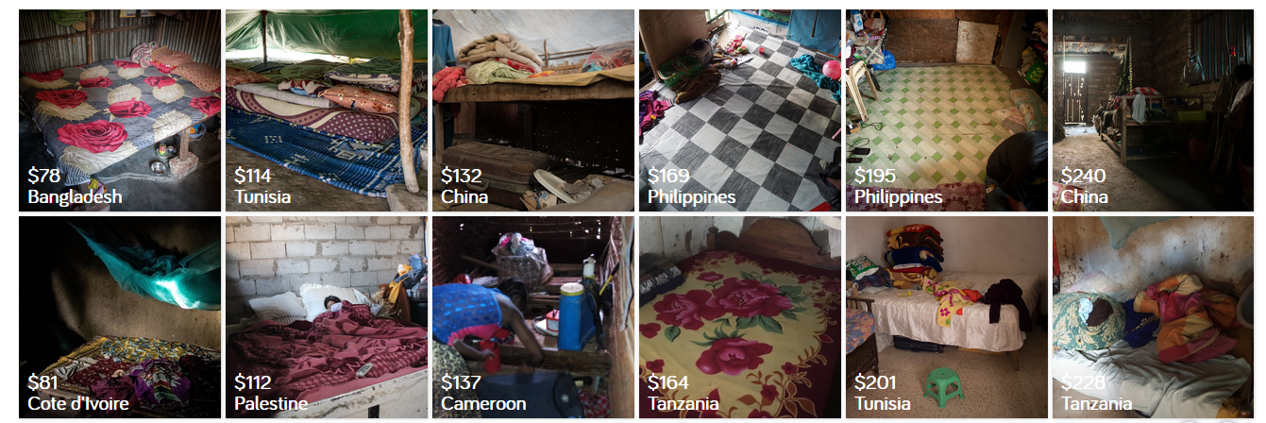

Slide 12
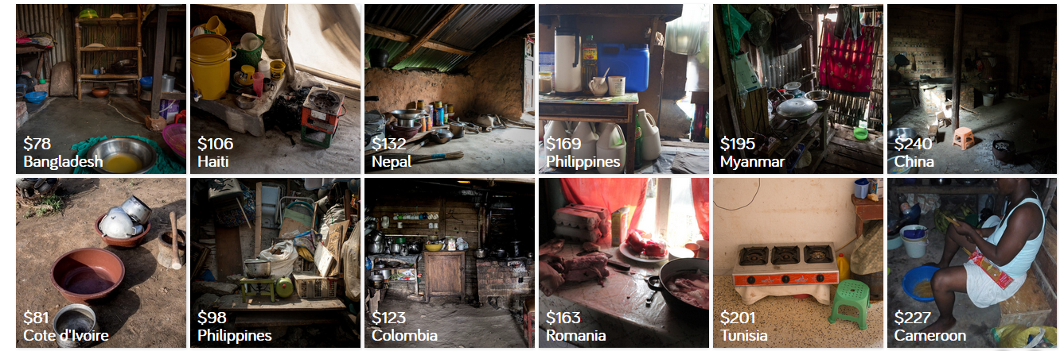

Slide 13
WORLD POPULATION (7 billion)
by four income levels
L1
L2
L3
L4
Low Income
(Extreme poverty)
Middle
Income
High Income

Slide 14
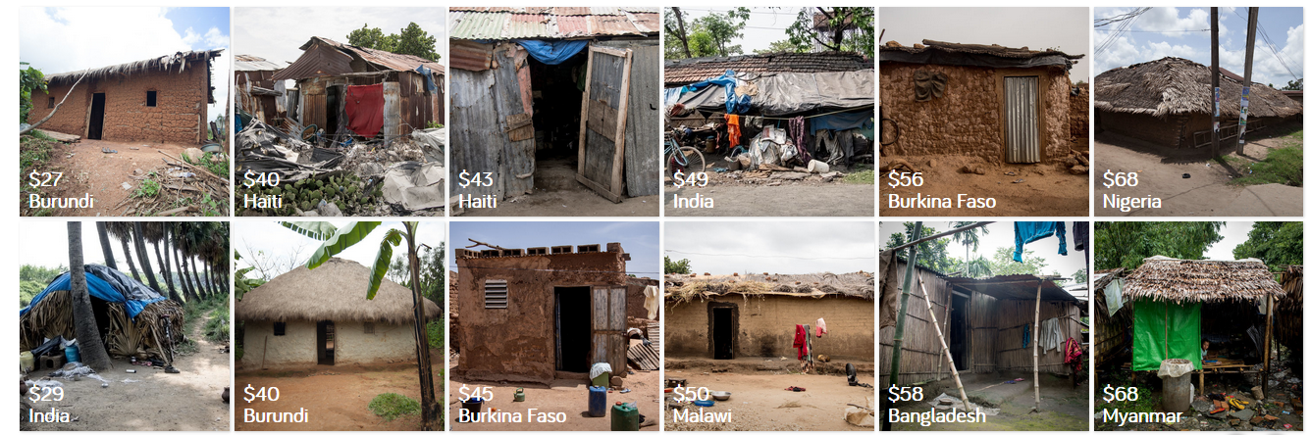

Slide 15
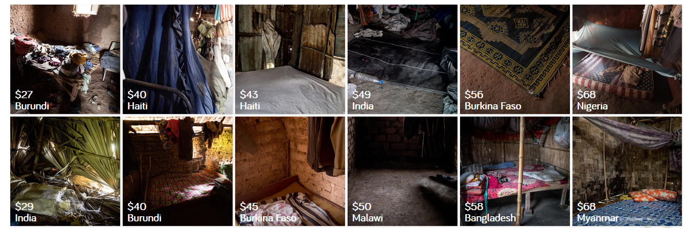

Slide 16
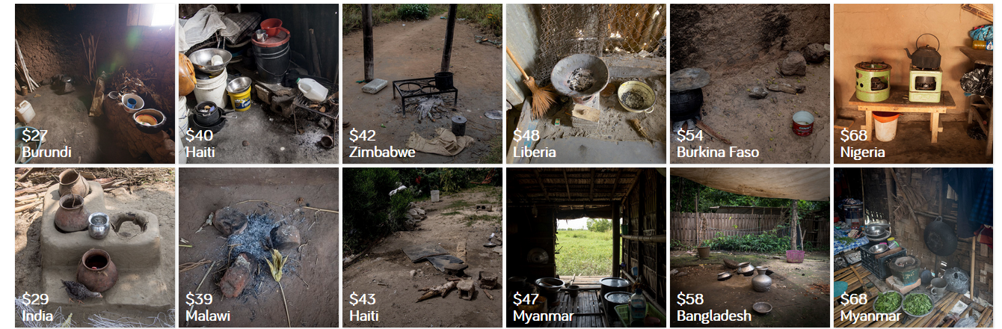

Slide 17
WORLD POPULATION (7 billion)
by four income levels
L1
L2
L3
L4
Low Income
(Extreme poverty)
Middle
Income
High Income

